Slide 1
International Food Trends
US, March 2016

Slide 2
The Issues
Moderate growth projected
Lack of familiarity an obstacle to wider use
Restaurant sales represent a challenge

Slide 3
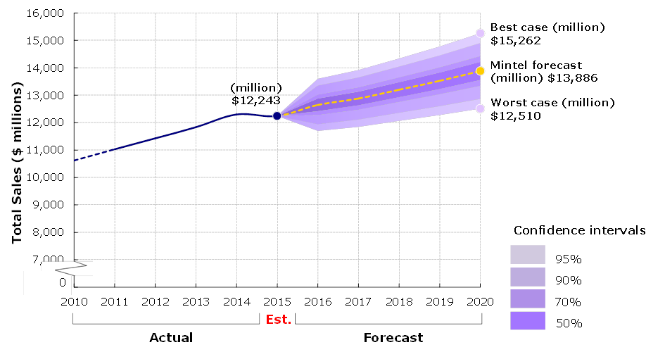
Moderate growth projected
Sales of international foods are expected to grow moderately in the near term, from $12.2 billion in 2015 to $13.9 billion in 2020 . A potential limitation to growth is lack of consumer familiarity with less mainstream ethnic cuisine; 33% of consumers cite unfamiliarity as a reason for not eating one or more types of international food .
MULO sales and fan chart forecast of international foods, at current prices, 2010-20
Source:

Slide 4
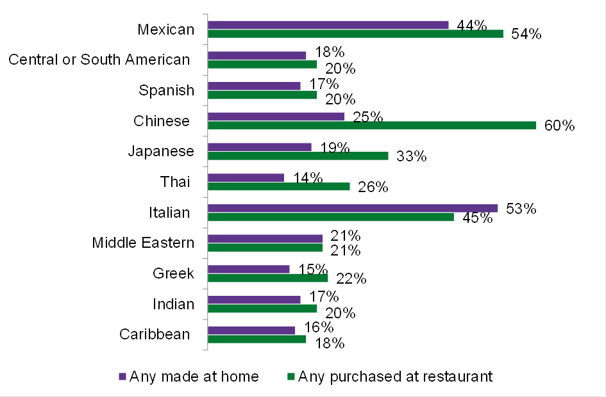
Restaurant sales dominate occasions but fuel interest for at home trial
Consumers are more apt to say they eat international foods at restaurants rather than prepare them at home, with very few exceptions (such as Italian or Mexican). Consumers are very likely to say the number of international food restaurants near their homes has increased, and that their consumption of these foods at restaurants has also increased. Consumer trial of international cuisines and the growth of consumption are directly tied to the restaurant experience. While restaurant sales of international foods may represent a challenge to retail sales of international food products, they are also the conduit that introduced these foods to the consumer, grocery stores and other channels.
International food consumption, November 2015
Base: 2,000 internet users aged 18+
Source: Lightspeed GMI/Mintel

Slide 5
The Opportunities
Focusing on Millennials
An opportunity to leverage authenticity
Anticipating demand for emerging ethnic cuisine

Slide 6
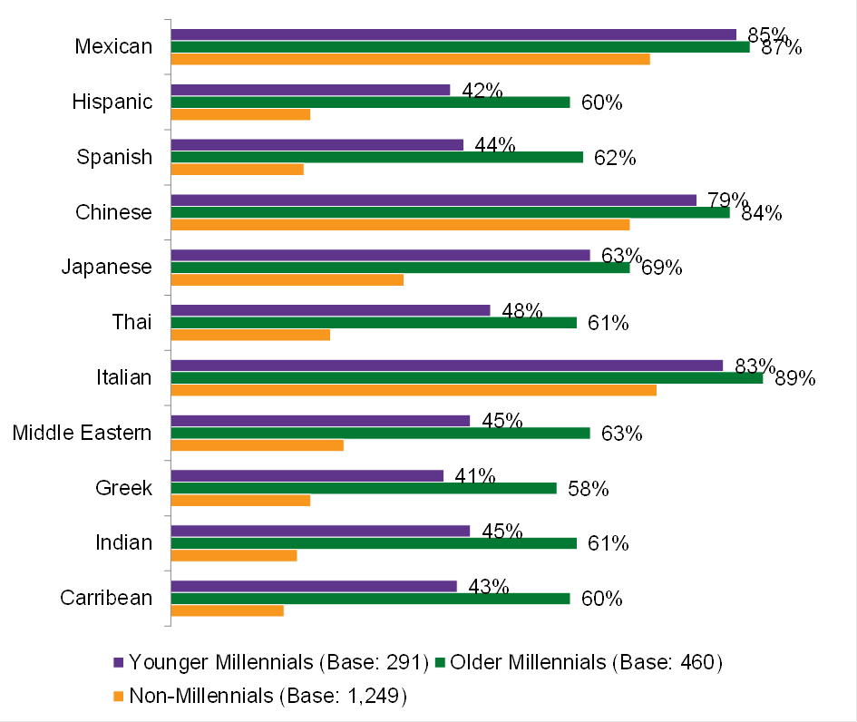
Focusing on Millennials
Millennials are more apt than other generations to say they have eaten a wide range of international foods in the last three months. Millennials are renowned for their adventurous palates and desire for unique, authentic culinary experiences, which means ethnic foods are likely to resonate with this group. This, coupled with their status as the most populous generation, means Millennials represent an enormous opportunity for international food brands.
International food consumption, by Millennials vs. non-Millennials, November 2015
Base: 2,000 internet users aged 18+
Source: Lightspeed GMI/Mintel

Slide 7
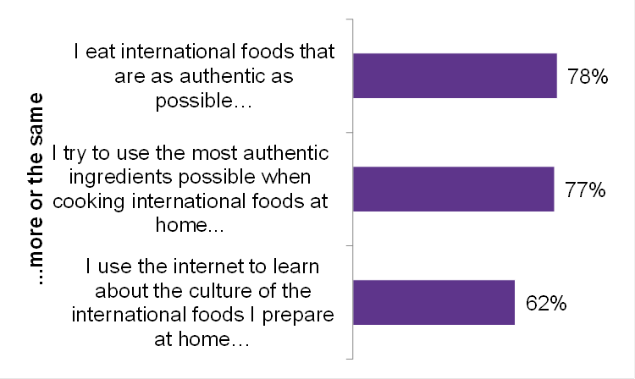
An opportunity to leverage authenticity
International food users are very likely to report having increased/maintained their consumption of authentic international foods and their use of authentic ingredients in the last year. Users have also increased/maintained their research of international foods via the internet. The net result is that authenticity is ever more important to international food users and that they are becoming increasingly able to detect and avoid less authentic versions.
Changes in behavior regarding international foods- authenticity, November 2015
Base: 1,005 internet users aged 18+ who prepare international packaged food products or meal kits
Source: Lightspeed GMI/Mintel

Slide 8
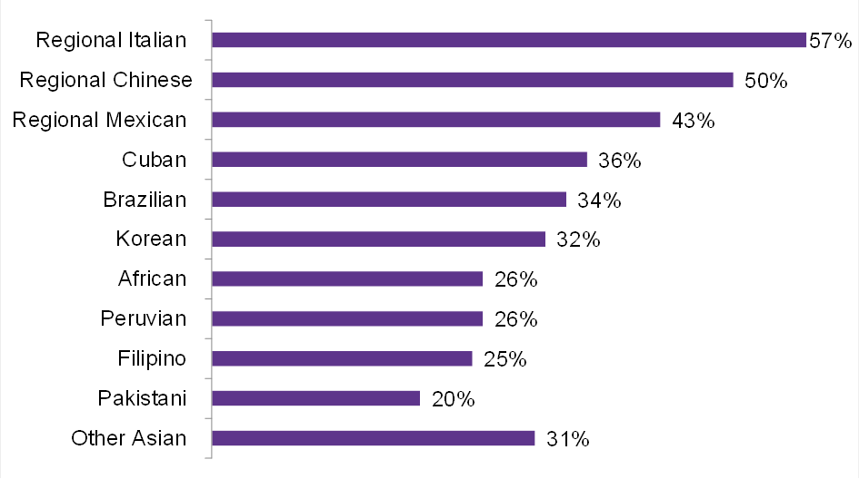
Anticipating demand for emerging ethnic cuisine
Consumers are significantly likely to report interest in a number of different emerging international foods. They report the most interest in regional Italian, Chinese, and Mexican, but also significant interest in less mainstream cuisines such as Cuban, Brazilian, Korean, and others. Brands that offer products featuring these types of cuisines, as well as their ingredients and dishes in an authentic way have an opportunity to increase penetration.
Interest in Emerging International cuisine, November 2015
Base: 2,000 internet users aged 18+
Source: Lightspeed GMI/Mintel

Slide 9
What it Means
The increasingly multicultural society in the US has greatly influenced the interest and growth of international food sales. Additionally, cooking shows, international travel, food bloggers, celebrity chefs, and retail outlets like Eataly and Latinicity have peaked consumer curiosity and removed barriers to trial. Enhanced consumer awareness of ethnic cuisines and brands that emphasize authenticity is furthering the momentum of international food sales. Focusing on groups that report a high likelihood to eat international foods, such as Millennials and Hispanics, will also drive growth.

Slide 10

Paul Pendola
Category Manager, Foodservice
ppendola@mintel.com
mintel.com

